Slide 1
Propagation Media
Week#2

Slide 2
Soilless Media
Soilless media varies depending on the propagation type and plant type
Ex: cuttings vs seeding
Media can come pre-mixed by a supplier or mixed at the nursery using a chosen recipe
Most pre-mixed media contains peat moss, perlite and/or vermiculite
Amendments such as lime may also be added to adjust the pH

Slide 3
Organic Components of Media
Peat moss
Bark
Coir or Coco fiber
Sawdust
Rice hulls

Slide 4
Peat Moss
Partially decomposed plant residue
Formed in wet areas
Environmental concern is the depletion of peat bogs due to aggressive removal of peat.
Light tan peat moss has very high water holding capacity (up to 60% of its volume in water)
Darker peat has greater water and nutrient retention but lower drainage capacity
The pH of peat moss is very low (3 to 4)

Slide 5
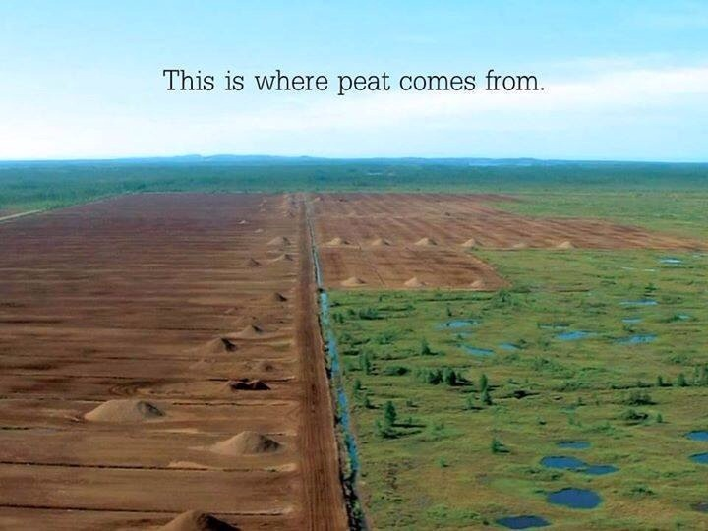
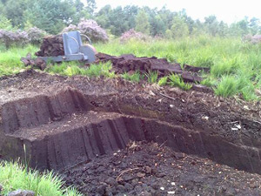
http://static1.squarespace.com/static/544591e6e4b0135285aeb5b6/t/55476d76e4b0ebaf8fae6a3a/1430744438418/image.jpg
http://www.greenstrides.com/images-wp/peat-bog.jpg

Slide 6
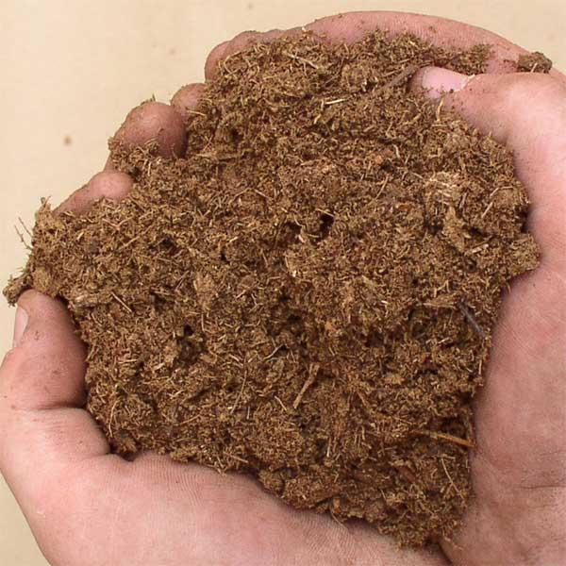
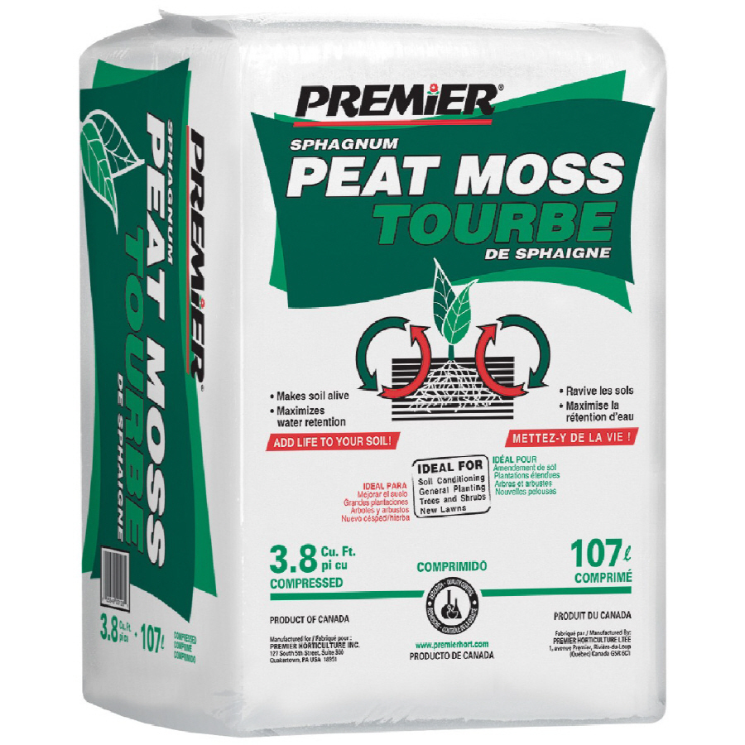
http://www.hidroponia.denivel.com/wp-content/uploads/2014/11/peat-moss-3.jpg
http://mobileimages.lowes.com/product/converted/025849/025849000820.jpg

Slide 7
Bark
In BC Douglas fir and hemlock are the primary sources
In eastern Canada pine is the primary source
Bark used for growing media is ground up and screened to various sizes
Screened bark is left to age in the rain or under sprinklers to leach out any salts
Piles are also heated to rid of any possible plant diseases
The process is repeated three times
Bark absorbs growth regulators
A 25% increase of growth regulators is applied to plants where bark is part of the potting mix

Slide 8
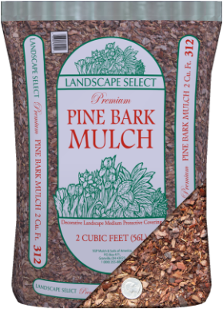
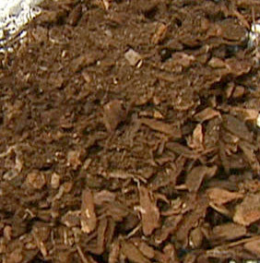
http://www.sgpmulch.com/uploads/3/1/0/9/3109567/8658871.png?1343316653
http://garden.org/ideas/view/RickCorey/652/Adding-Screened-Bark-to-Potting-Mix/

Slide 9
Coir or Coco Fiber
It is composted coconut husk fiber
Produced in Southeast Asia and shipped to North America in compressed block-like bricks
Blocks are left out in the rain for several weeks to expand and leach salts
Holds a great deal of moisture but provides lower levels of aeration than peat moss
Less hydrophobic (ability to repel water) than peat
pH is 4.9-6.8

Slide 10
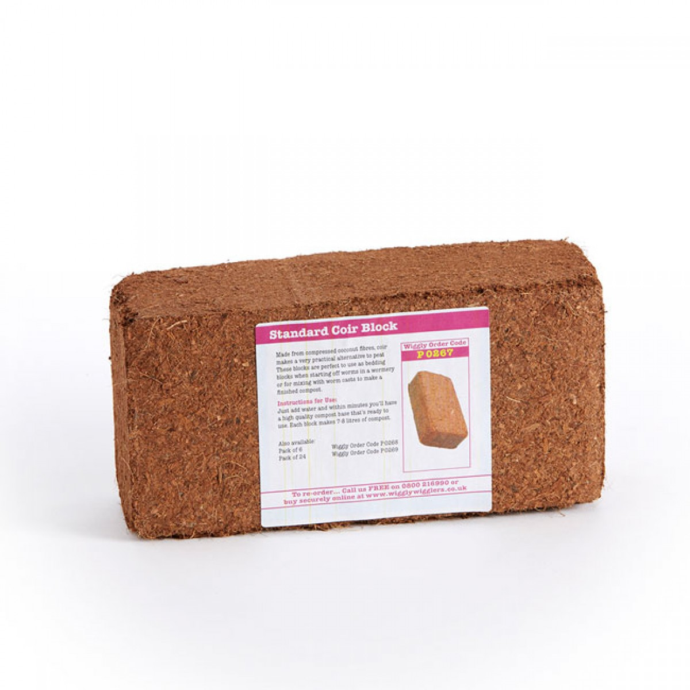
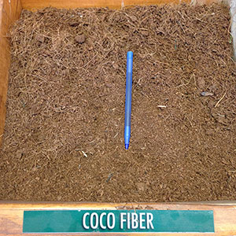
http://www.wigglywigglers.co.uk/media/catalog/product/cache/1/image/1200x1200/9df78eab33525d08d6e5fb8d27136e95/0/7/075_coirblock01.jpg
http://www.989rock.com/public/images/pictures/products-lg/soil-enhancers/soil-enhancers-coco-fiber-01-xl.jpg

Slide 11
Sawdust
Was used in the 1970s and 1980s in nursery container mixes
Retains some moisture but assists in drainage
Breaks down quickly therefore shrinking the mix in volume and poor drainage
Ties up nitrogen due to the high carbon to nitrogen ratio
Sawdust is still used in the industry today but in small quantities

Slide 12
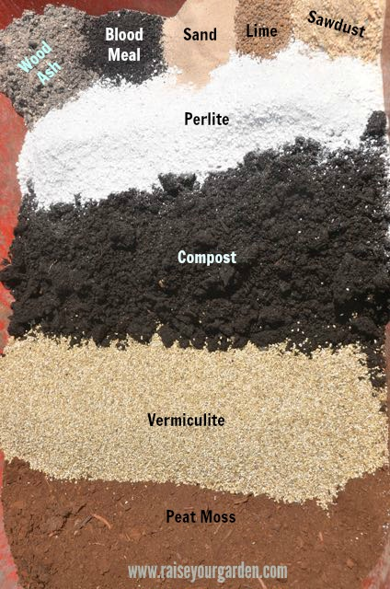
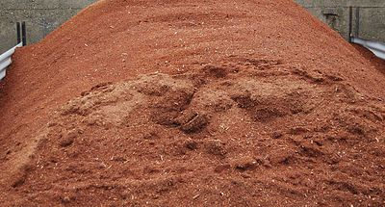
http://static.wixstatic.com/media/ebf4f7_933b2a00616d46cdb41696f2b682905a.jpg/v1/fill/w_400,h_215,al_c,q_80,usm_0.66_1.00_0.01/ebf4f7_933b2a00616d46cdb41696f2b682905a.jpg
http://www.raiseyourgarden.com/uploads/2/8/1/4/28144805/3322288_orig.jpg

Slide 13
Rice Hulls
Thin, feather-light with the thin, pointed shape of rice grains
Used to improve drainage and water retention
Used in soil mixes instead of perlite
Can substitute bark as they do not absorb growth regulators
The pH of rice hulls ranges from 5.7-6.5

Slide 14
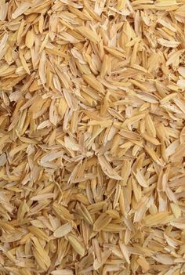
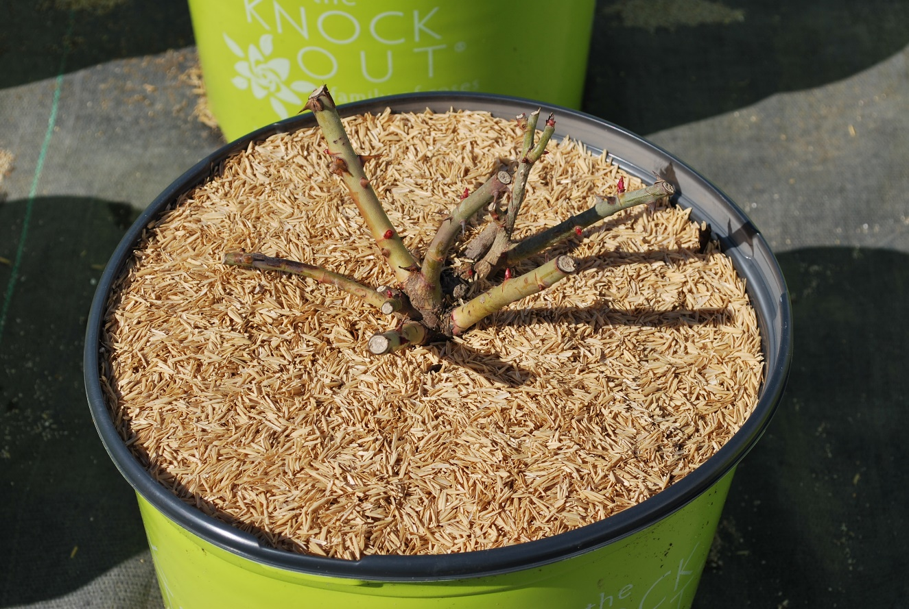
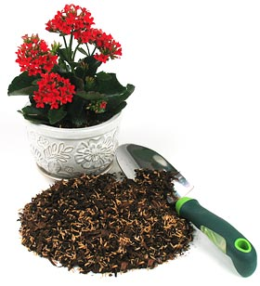
http://www.riceland.com/uploads/pages/top_dress_pbh_018.jpg
https://s-media-cache-ak0.pinimg.com/236x/6a/d9/2c/6ad92cb25d6c0ac2f5391522592cd83f.jpg
http://cdn.arbico-organics.com/images/insets/rice-hull-potting-mix.jpg

Slide 15
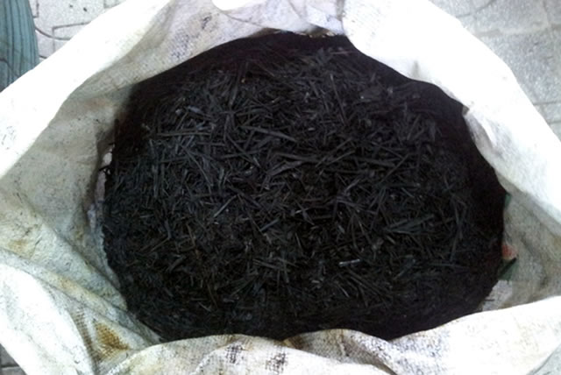
Biochar
Produced by a process called Pyrolysis
Cooked at low temperature of 400-500 degrees Celsius
Made from organic materials: straw, woody plants, manure and animal processing by-products
Has a porous structure
Retains water and nutrients
Great habitat for microorganisms
Reduces soil acidity
Prevents algae growth
Increases yields

Slide 16
Inorganic Components
Vermiculite
Perlite
Pumice Stone

Slide 17
Vermiculite
Plate-shaped mineral rock
Processed by rapidly heating to 1000 ⁰C. Water trapped between the layers causes the particles to expand during evaporation.
In a potting mix the water and nutrients are retained between the layers of the particles.
Has some nutrient content: magnesium, calcium and potassium
Particle size varies with product grade
Used in indoor propagation and potting mixes

Slide 18
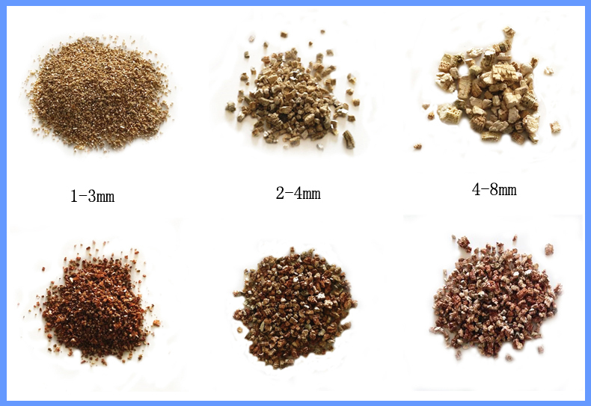
Grades of Vermiculite
http://g03.s.alicdn.com/kf/HTB1RVXYHpXXXXX2XVXXq6xXFXXXL/200168105/HTB1RVXYHpXXXXX2XVXXq6xXFXXXL.jpg

Slide 19
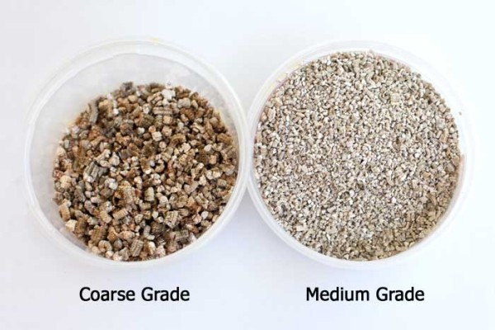
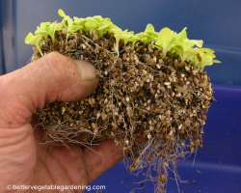
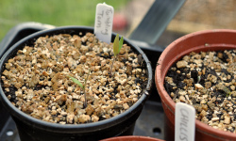
http://www.melbartholomew.com/wp-content/uploads/2013/08/vermiculite-grades-600x400.jpg
http://www.bettervegetablegardening.com/images/horticultural-vermiculite-only-starting-seeds-roots.jpg
http://www.gardensure.com/wp-content/uploads/2014/12/vermiculite-seed-covering-250x150.jpg

Slide 20
Perlite
Crushed volcanic rock heated rapidly to 1000 ⁰C
Particles expand to form a light weight, white granule
The outside of each granule wets easily but the pores within the granules are sealed
Used to ‘loosen’ a mix and improve drainage without adding weight
Used in indoor propagation and potting mixes

Slide 21
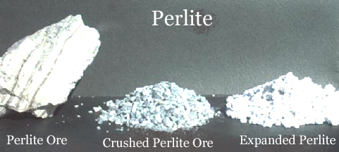
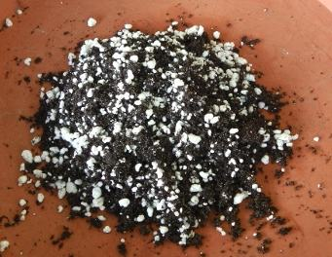
http://www.perlite.com.eg/images/perlites.jpg
http://www.tomatogrowing.co.uk/wp-content/uploads/2014/01/Perlite-Soil.jpg

Slide 22
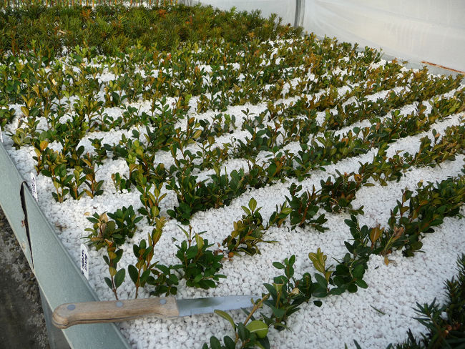
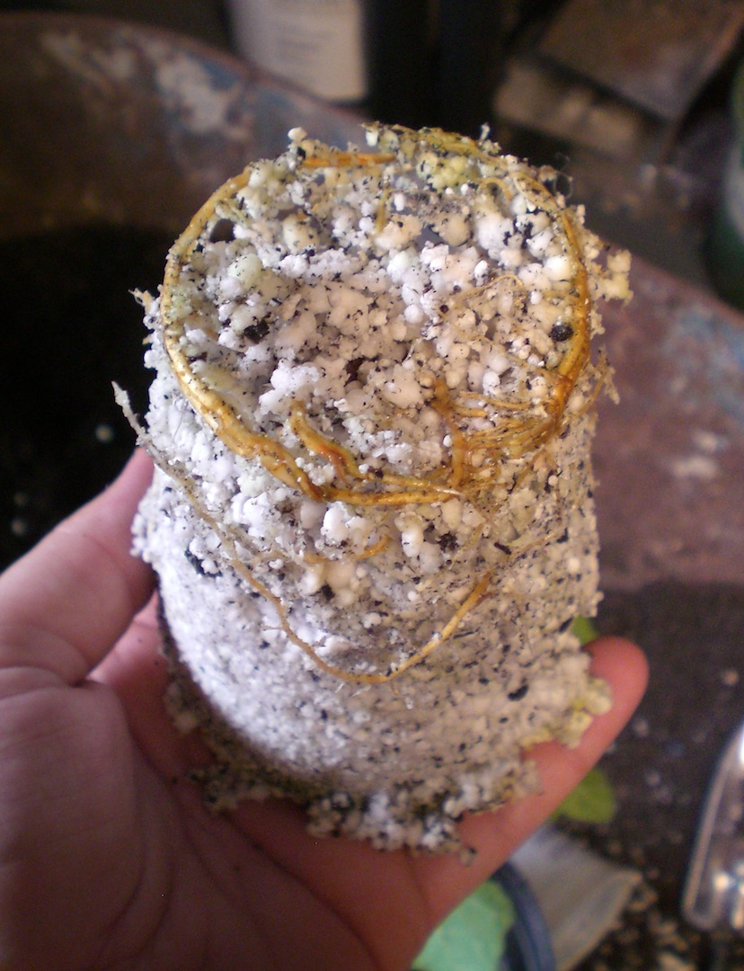
http://www.theobserver.ca/2016/02/12/most-new-plants-started-by-stem-cuttings-in-nursery-industry
http://4.bp.blogspot.com/-9J1Q7axwJMo/ThemwdqFzJI/AAAAAAAAARk/vnIFdcZjaGk/s1600/CIMG0640.JPG

Slide 23
Pumice Stone
Naturally occurring rock of volcanic origin
Formed from the quickly cooling rock blown out of the volcano
It is mined, ground and screened to various sizes
As it is porous it will retain some water and nutrients
Provides extra drainage
Often used in herbaceous perennial and green roof mixes

Slide 24
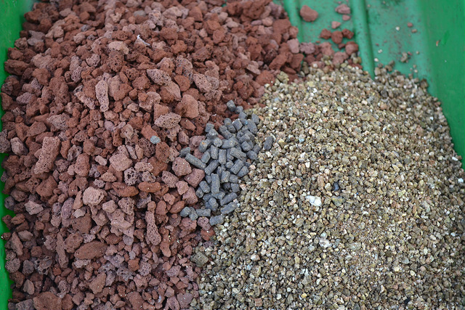
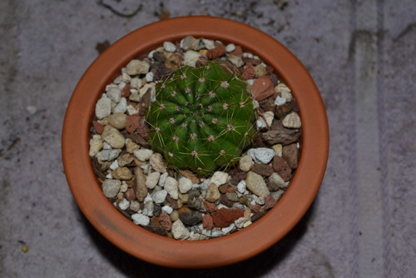
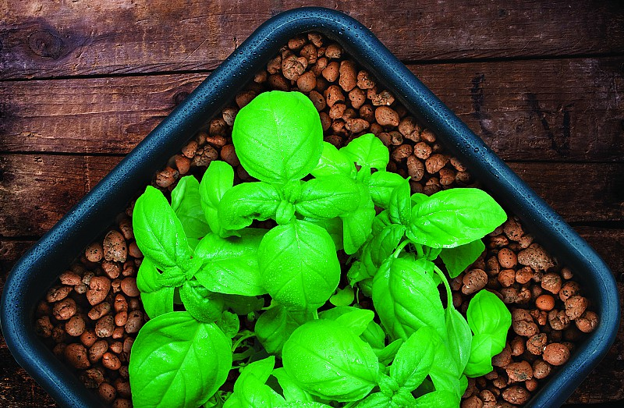
http://st.hzcdn.com/simgs/a7a24e4e06d9afc8_8-6894/home-design.jpg
http://farm4.staticflickr.com/3681/12419225404_8f7500c420_z.jpg
http://www.powerhousehydroponics.com/wp-content/uploads/2014/12/clay-pebbles-hydroponic-grow-medium.jpg

Slide 25
Types of Media
The components in soilless media will determine it’s porosity and water holding capacity.
Media should be based on the climatic conditions of the area
As media ages components break down which leads to higher water holding capacity

Slide 26
Perennial Mix & Nursery Mix
Perennial Mix contains finer bark (3/4 in minus)
Nursery mix is coarser (bark size 1 in minus)
Amendments are also used in the mix

Slide 27
Soil Amendments
Dolomite lime to adjust pH to about 5.8 and add calcium and magnesium
Triple Super phosphate to support root growth
Gypsum to add an extra source of calcium
Granular micro nutrients plus a liquid form of iron
A starter fertilizer of potassium nitrate (quick release) to support immediate growth and off set C/N ratio of bark

Slide 28
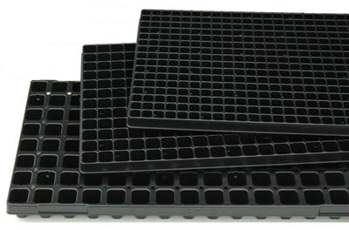
Propagation Containers

Slide 29
Seeding Trays
Can vary is the size of plugs depending on:
The size of seed
Seeding machine
Customer preference
Trays are identified by the number of cells they contain
Some common seeds starting trays are 324, 128, 105, 72, 50, or 38 cell

Slide 30
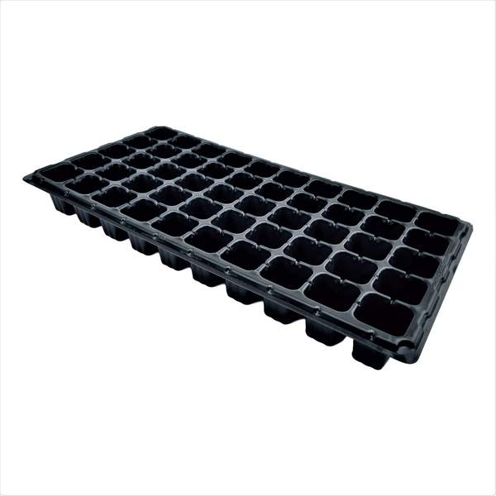
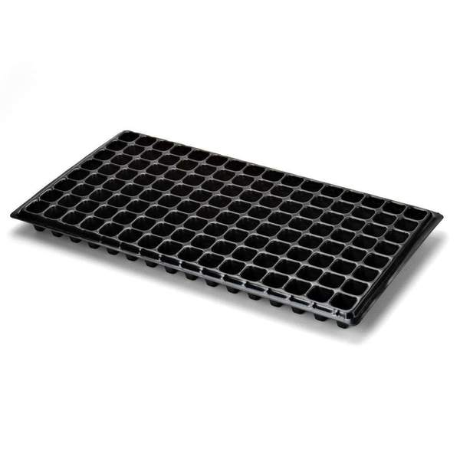
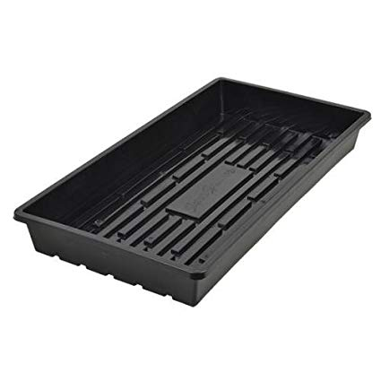
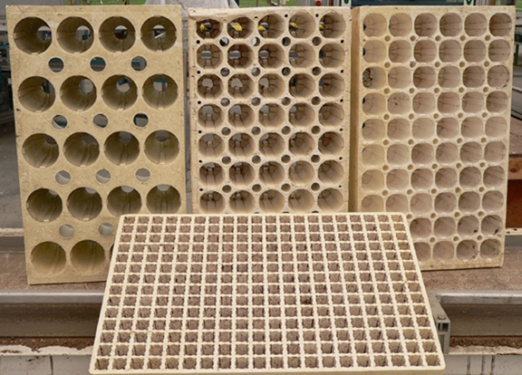
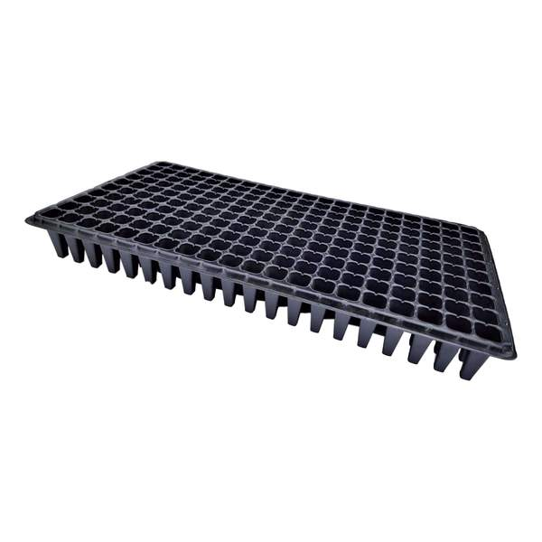
https://www.bootstrapfarmer.com/collections/seed-trays

Slide 31
Filling the trays with Media
Nurseries use automated pieces of equipment to fill trays
Speeds up process
More uniform and efficient
https://www.youtube.com/watch?v=unwthK-ZqVc

Slide 32
Plugs
Pre-formed, medium filled plugs are popular eg: Fertiss, Aero Plugs
Oasis foam plugs also used
Jiffy 7’s have been on the market for decades
Ellepot- pre-filled sleeve of premixed propagation medium
Q-plugs – mixture of peat and other amendments glued together with a binding agent. Holes are drilled into the center

Slide 33
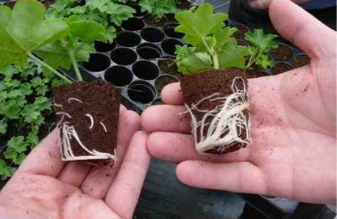
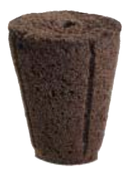
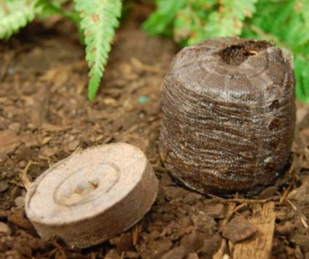
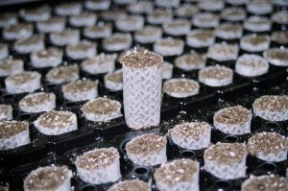
Q-plug
Preforma Plugs
Jiffy 7
Ellepots

Slide 34
Containers
May vary with plant type and production practices at each nursery
The size and shape of each plug must fit the next pot size

Slide 35
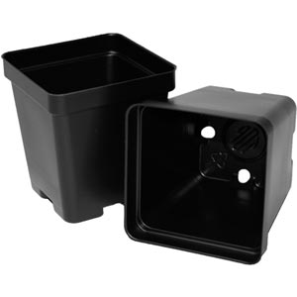
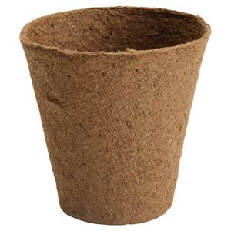
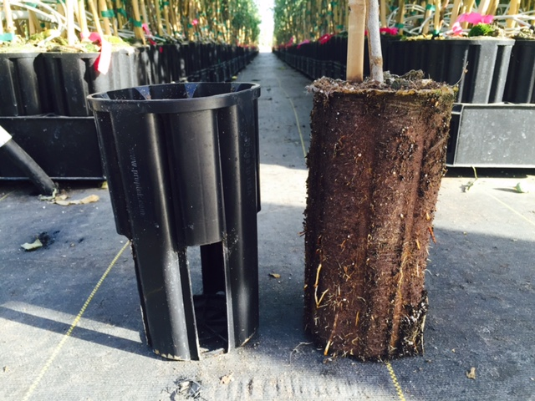
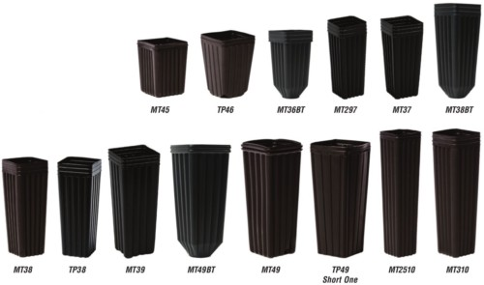
Transplanting/Cuttings Pots
http://www.nurserymag.com/article/automating-propagation-nursery-container-proptek/

Slide 36
Sanitation
Flats, tray inserts or pots need to be new or sanitized if reused
Soak pots in 1 part bleach to 9 parts of water for 10 minutes
Rinse with water

Slide 37
Questions?!!!

